Slide 1

About Me:
Abhik Banerjee
Blockchain Developer | Cloud Enthusiast | Flutter Enthusiast
CSE Undergrad at Netaji Subhash Engineering College.
On LinkedIn:
https://www.linkedin.com/in/abhik-banerjee-591081164/
On GitHub:
https://www.github.com/abhik-99

Slide 2
Kotlin in Blockchain Industry.
How this Language hailed as “The Better Java” changed the Blockchain Industry.

Slide 3
Topics to Cover.
What is Blockchain?
Public vs Private Blockchain.
Generations of Blockchain.
Cue the Hero – Kotlin.
The R3 Consortium and Corda.
How Kotlin is Used in Corda.
Why use Kotlin instead of Java?
Getting Started with Kotlin Training for Corda.

Slide 4
What is Blockchain?
“Blockchain, originally block chain, is a growing list of records, called blocks, that are linked using cryptography. Each block contains a cryptographic hash of the previous block, a timestamp, and transaction data (generally represented as a Merkle tree).
By design, a blockchain is resistant to modification of the data. It is "an open, distributed ledger that can record transactions between two parties efficiently and in a verifiable and permanent way". For use as a distributed ledger, a blockchain is typically managed by a peer-to-peer network collectively adhering to a protocol for inter-node communication and validating new blocks. Once recorded, the data in any given block cannot be altered retroactively without …”-
And the jargons continue…..

Slide 5
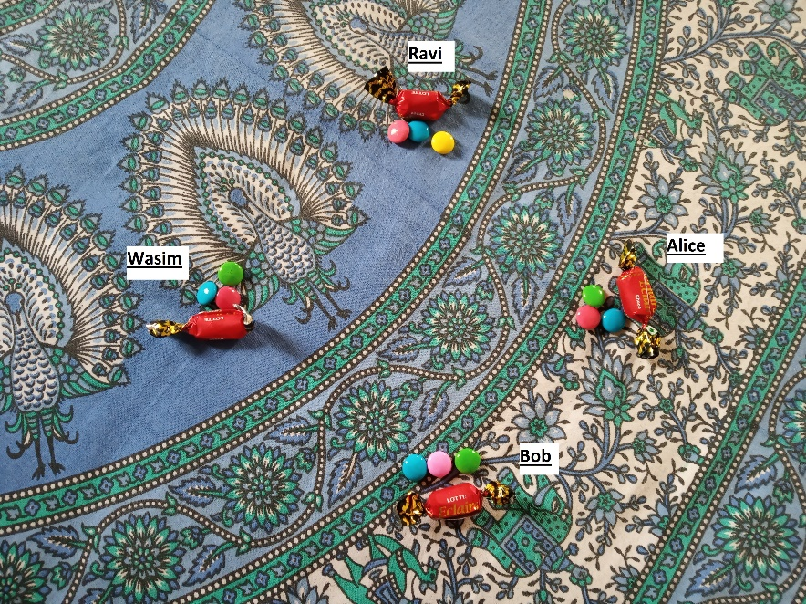
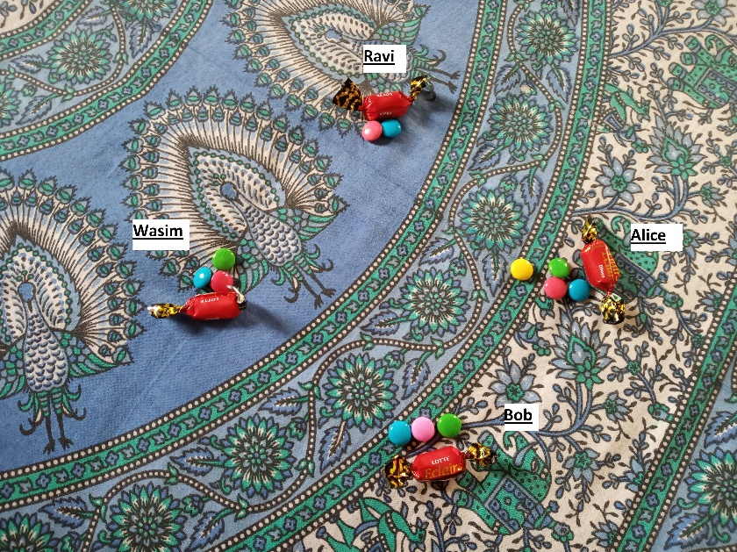
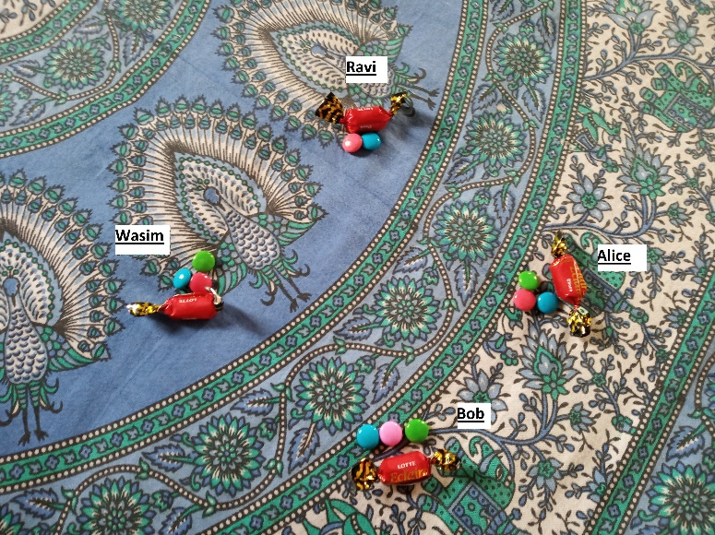
Blockchain is Best Understood by an Example.

Slide 6
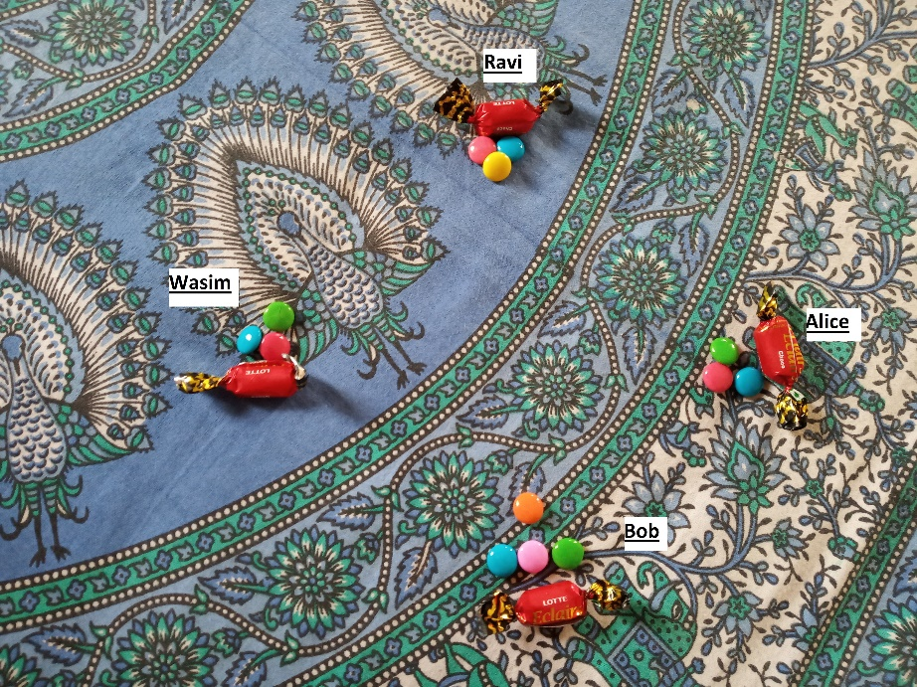
Case 2- Unknown Treasure Found!

Slide 7
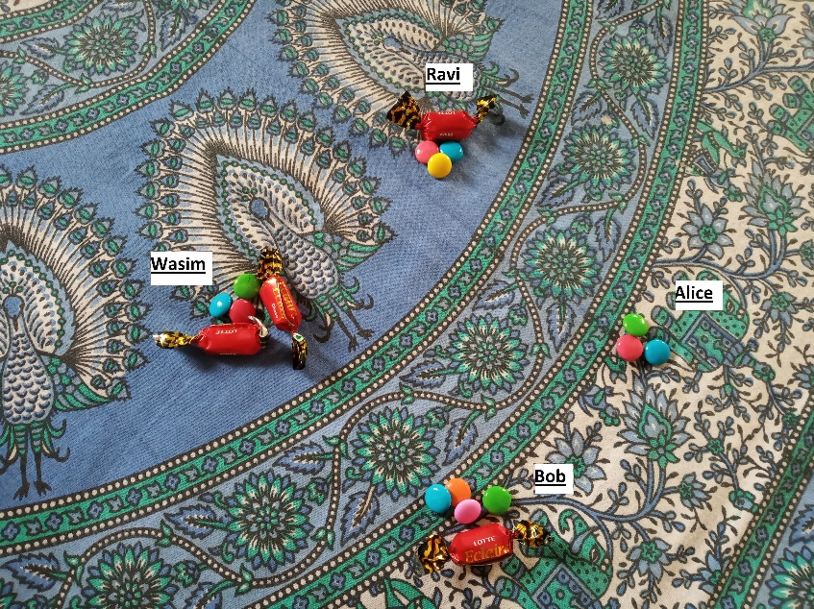
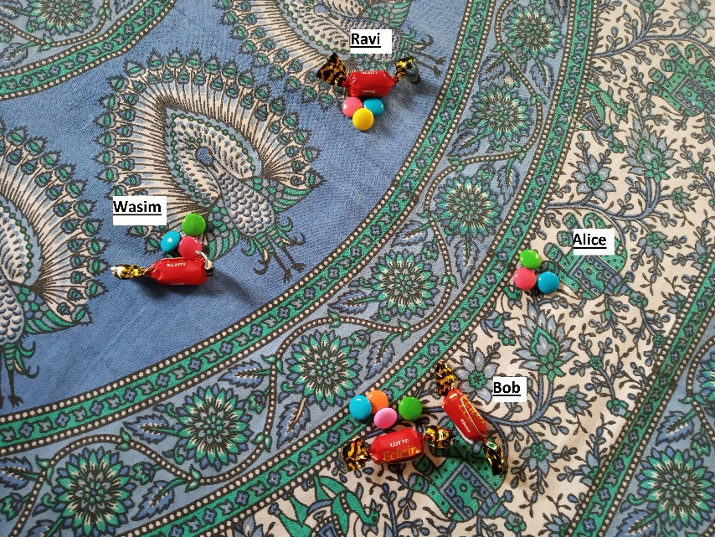
Case 3- The Double Eclairs Dilemma.

Slide 8
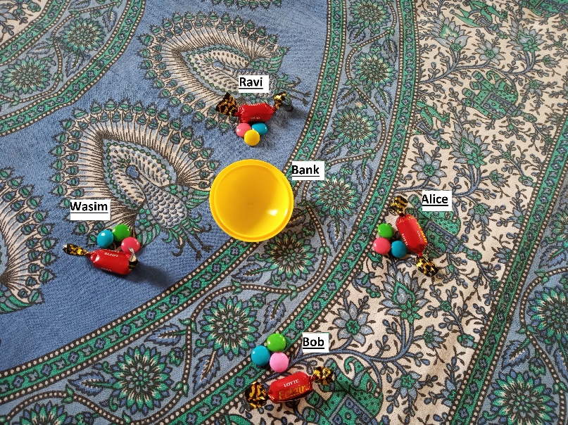
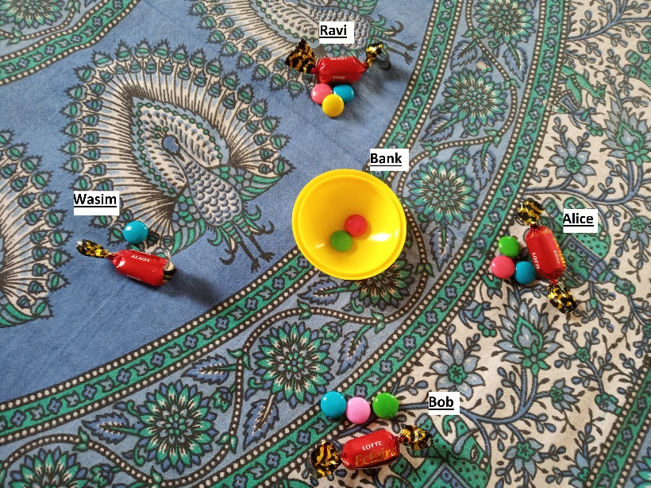
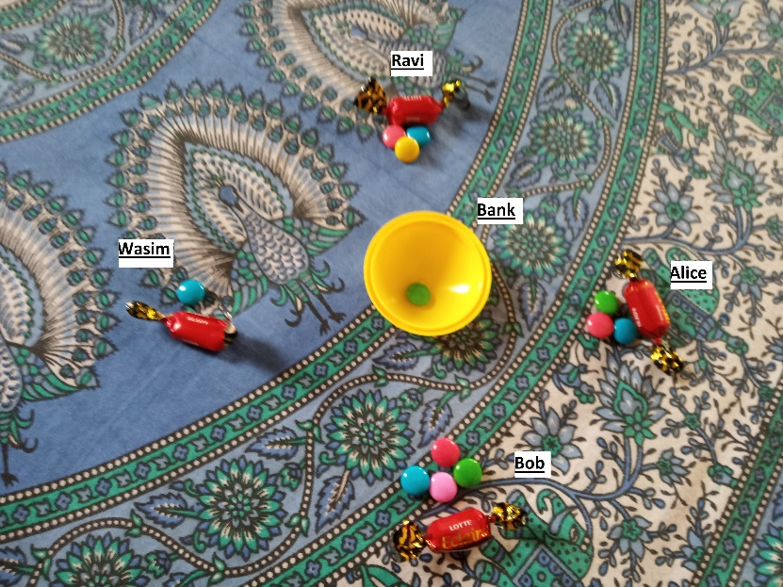
Case 4 – The Unfair Cut !

Slide 9
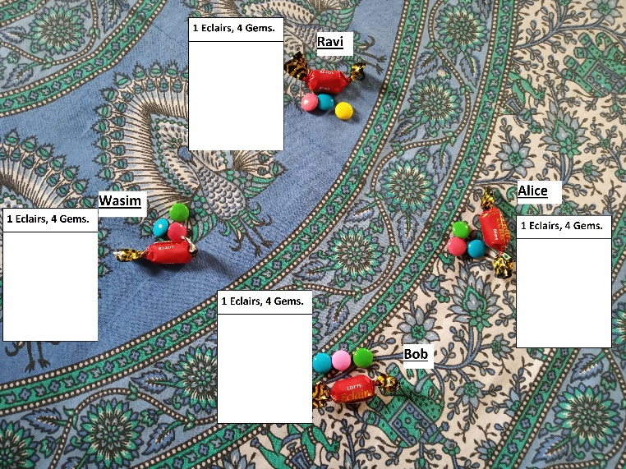
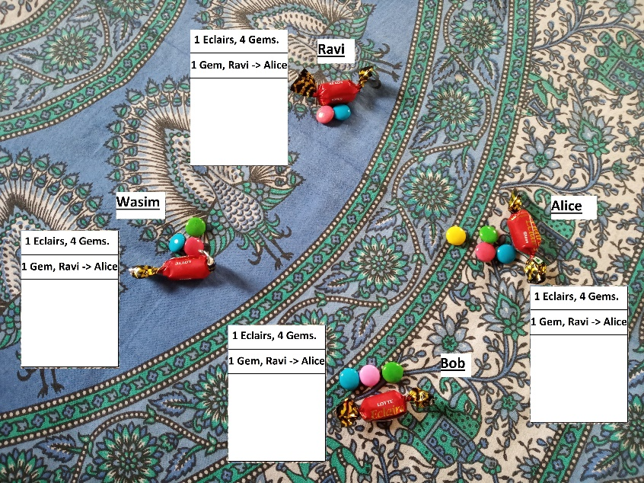
Enter Blockchain.

Slide 10
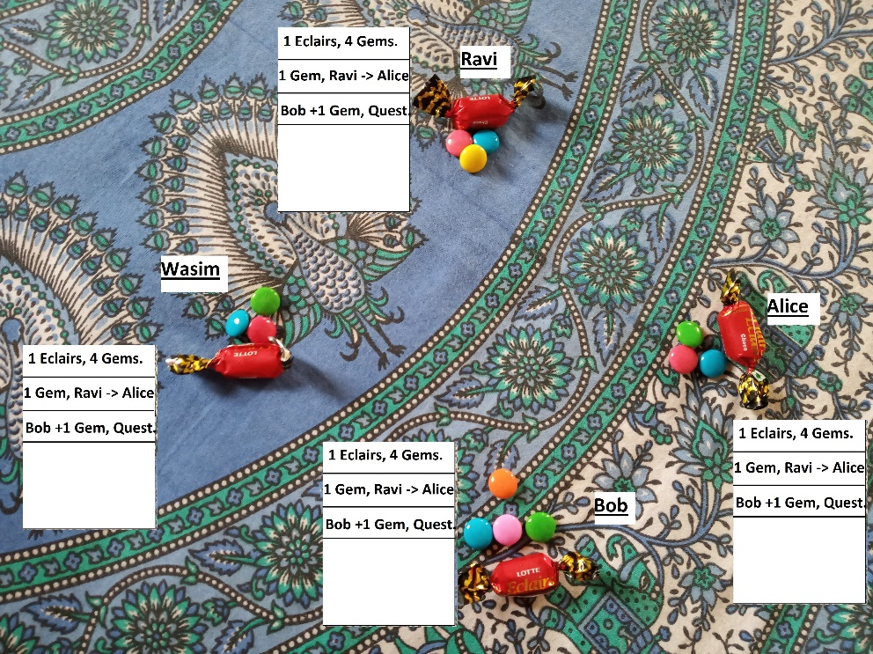
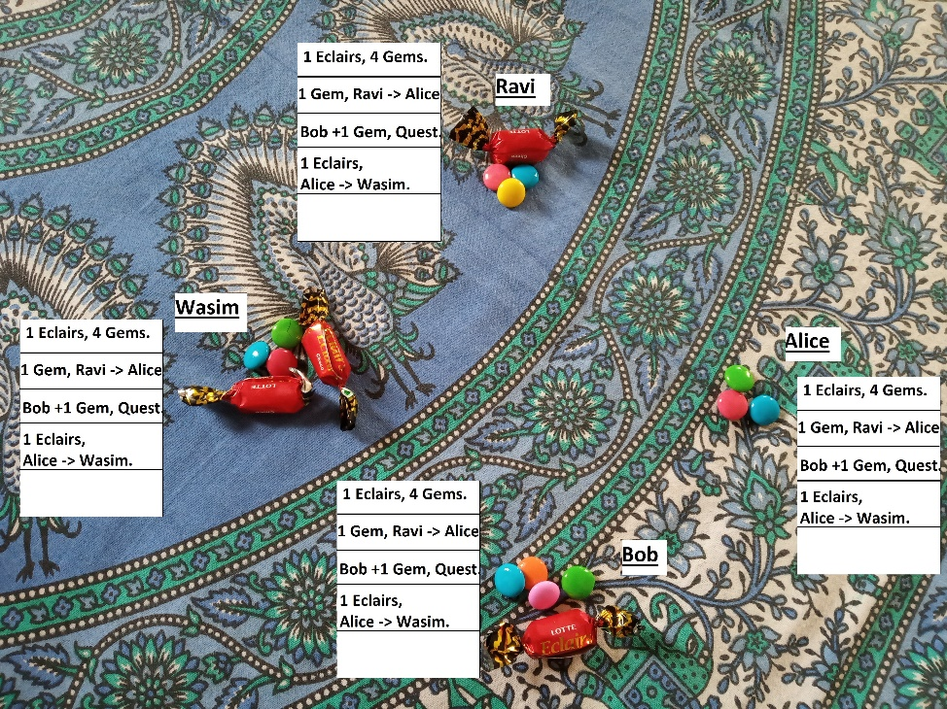
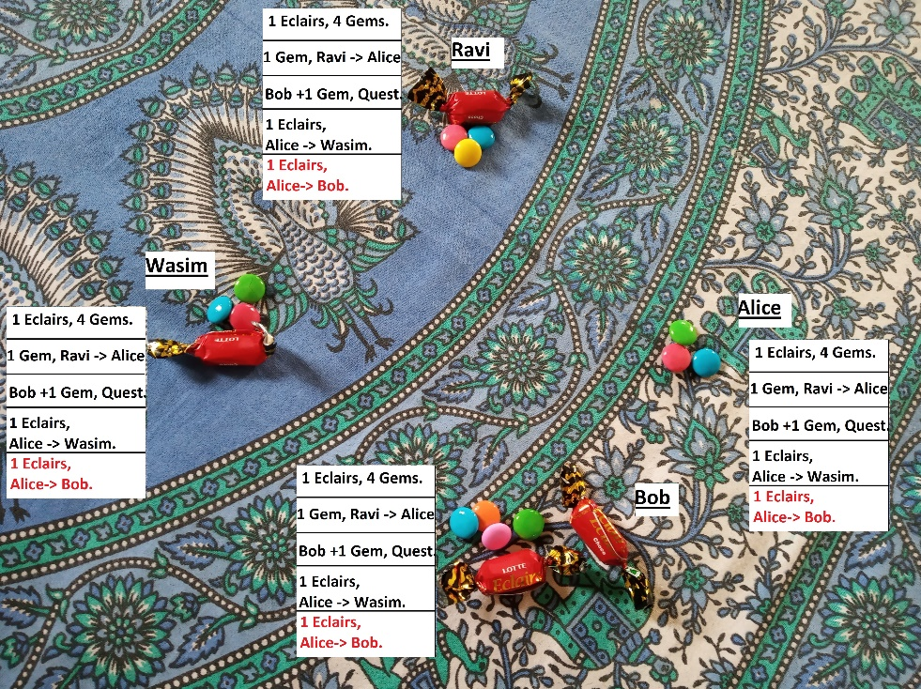
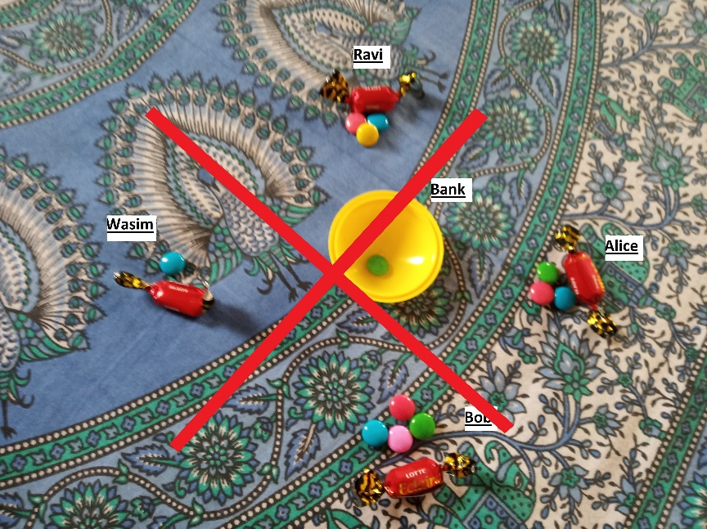

Slide 11
And That, is Blockchain- As easy as it can get!
Consider that each Action that was being taken as a “Record” or “Transaction”.
Together, many transactions are grouped together to form a Block.
And Each of these “Blocks” are consecutively arranged to form a “Chain”.
These “Chain” of “Blocks” or “Blockchain” is stored inside every “Node” that forms the “Network”.
Whenever a new Block is to be added, “Consensus” has to be reached. (BFT, PBFT, PoW, PoS,DPoS, PoET, and so on…)

Slide 12
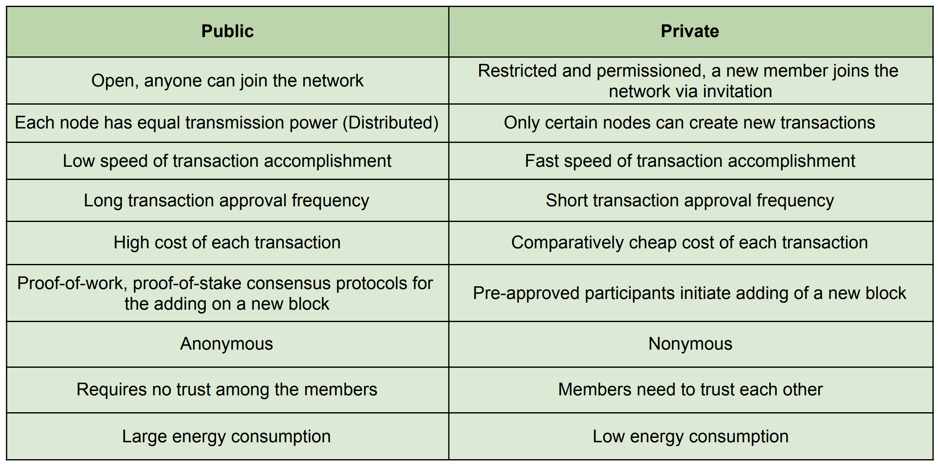
Public Blockchains vs Private Blockchains.

Slide 13
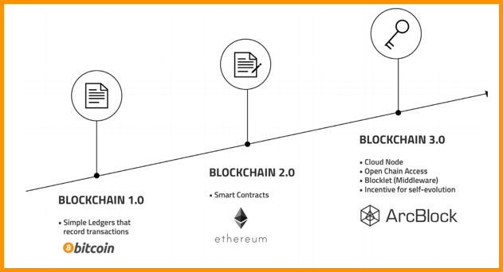
Blockchain and its Evolution.
https://medium.com/altcoin-magazine/the-four-blockchain-generations-5627ef666f3b

Slide 14
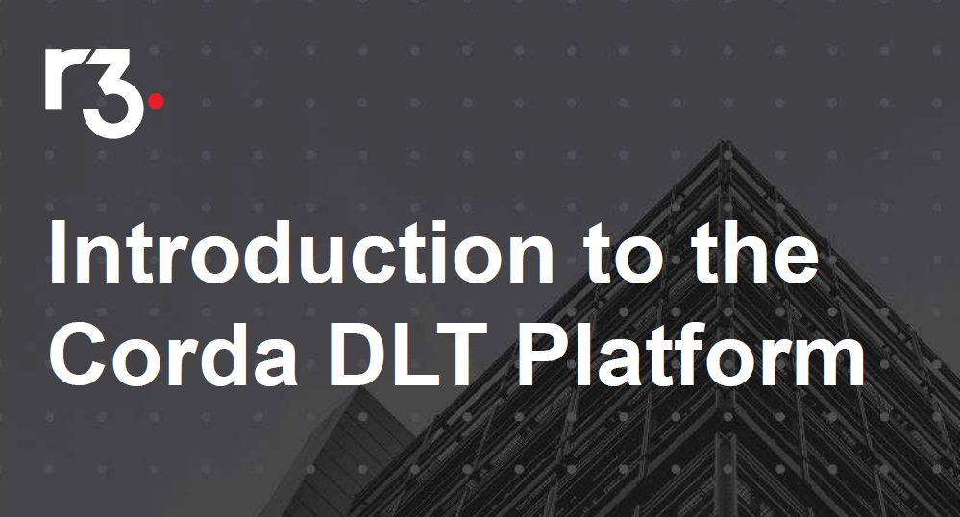

Slide 15
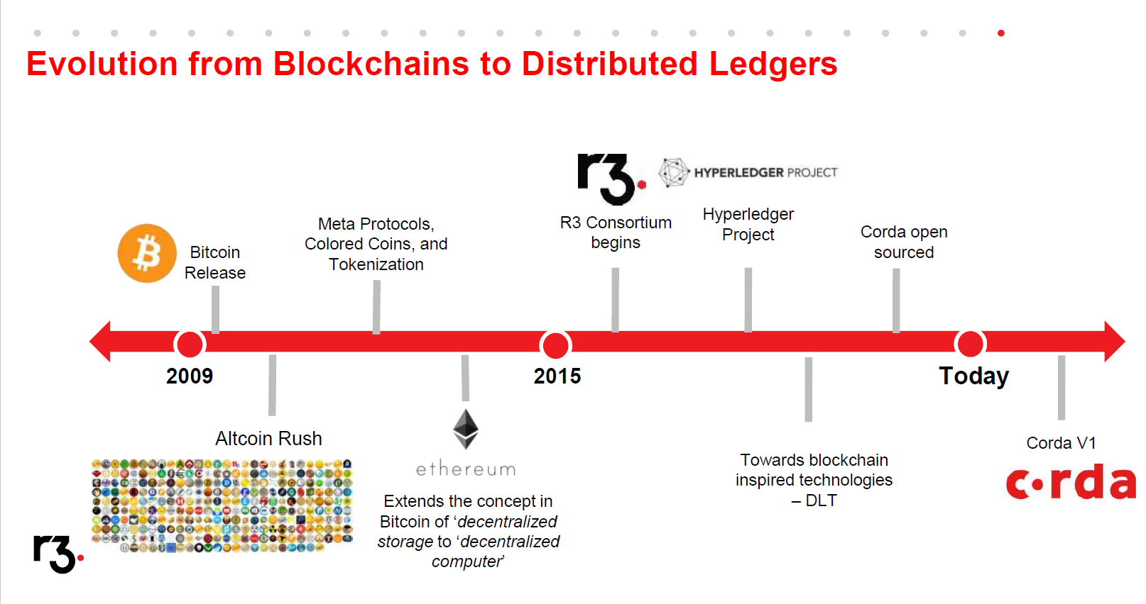

Slide 16
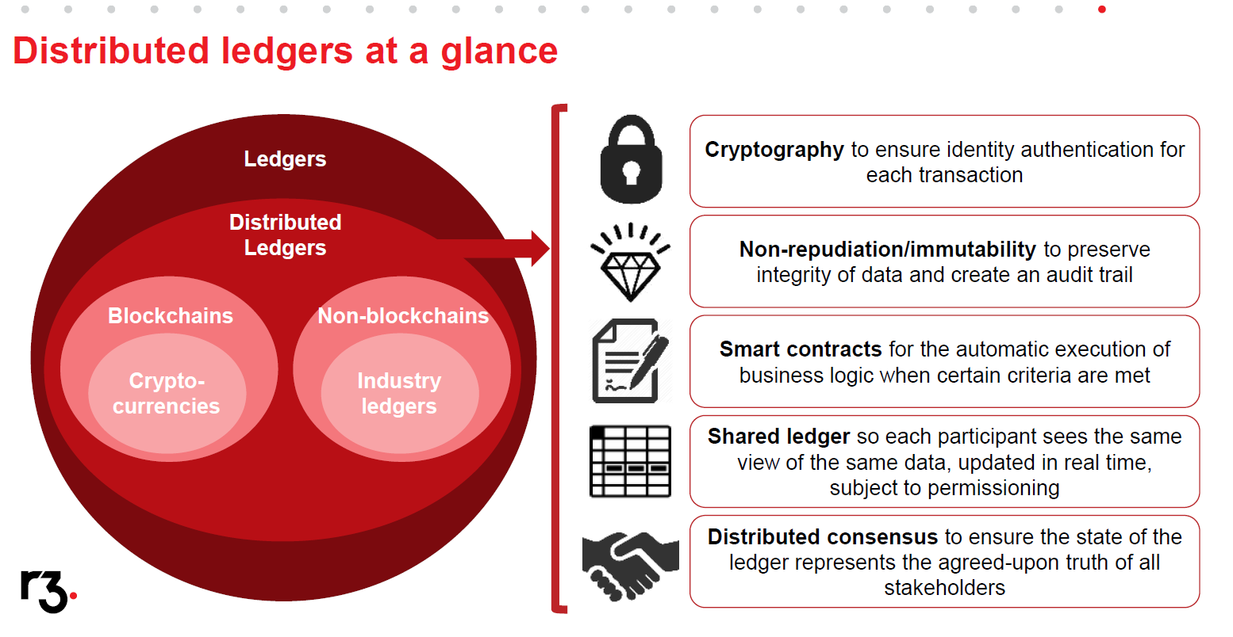

Slide 17
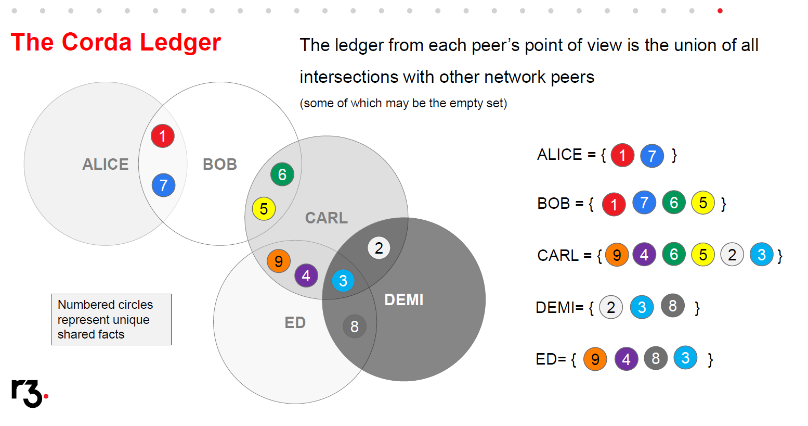

Slide 18
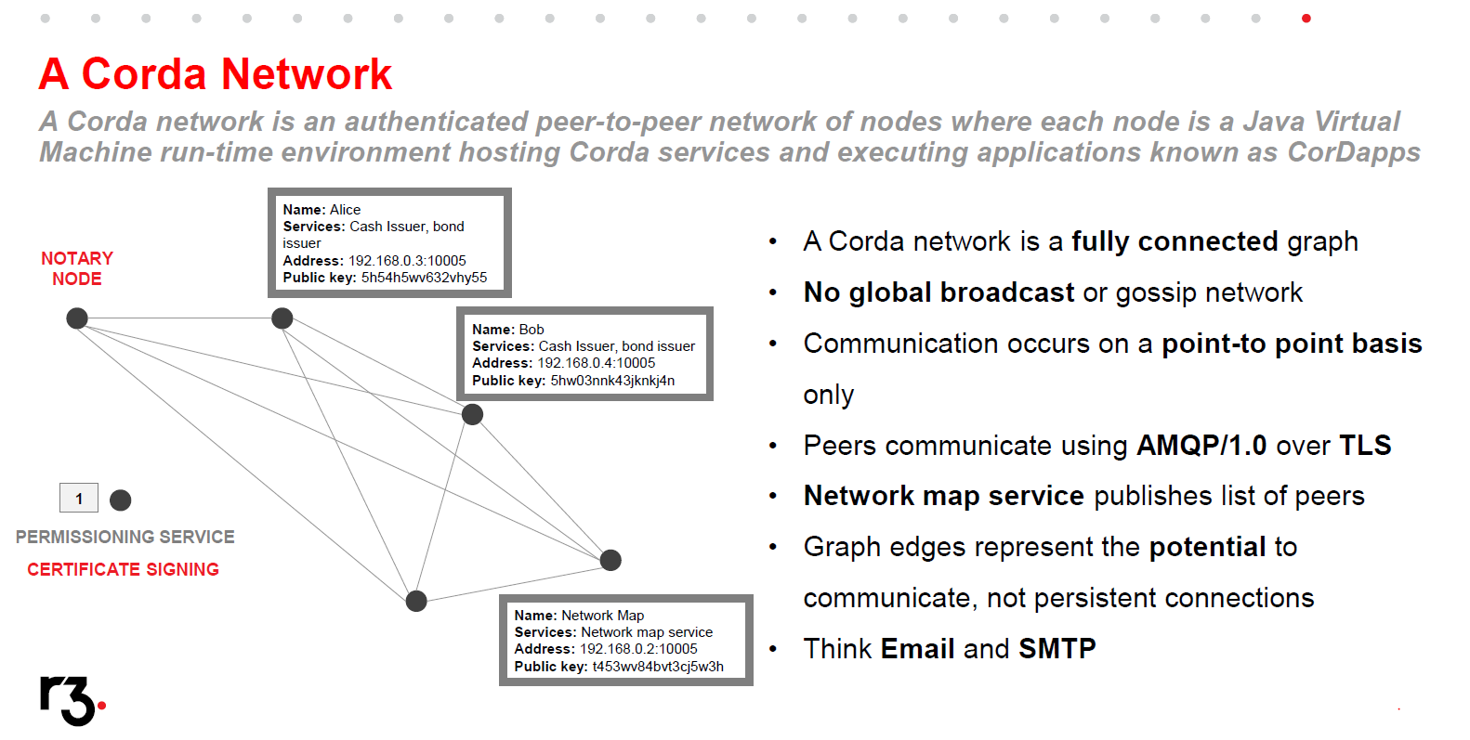

Slide 19
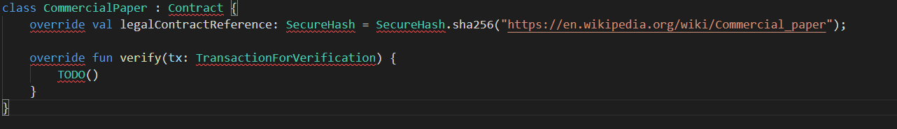
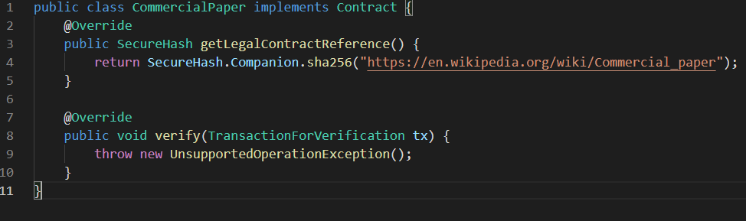
How and Why Kotlin in Corda?
Here’s Kotlin:
Here’s Java:

Slide 20
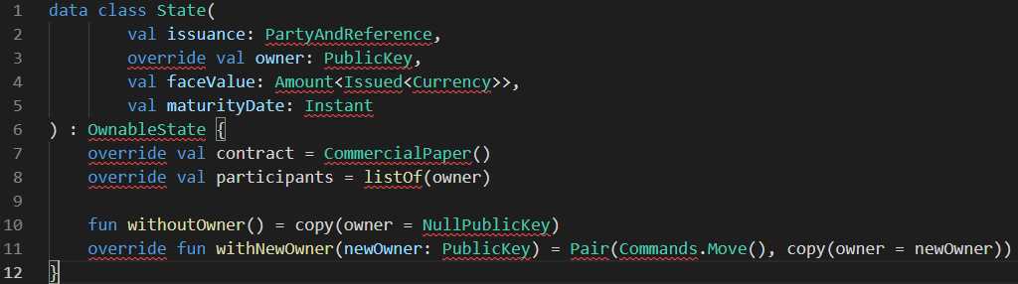
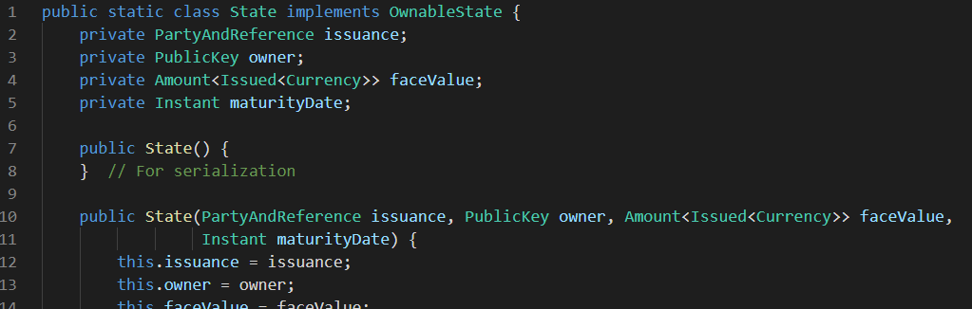
Here’s Kotlin:
Here’s Java:

Slide 21
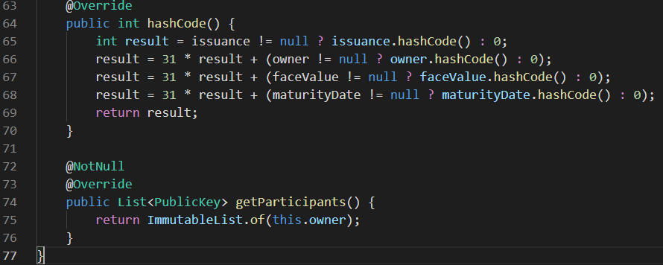
Oops.. The Code Overflowed?!

Slide 22
…But Why Else?
Less code shouldn’t be the only criteria you should choose Kotlin over Java…
You should choose to write your codes in Kotlin because:
The Bytecode generated by Kotlin is nearly same as that of Java. So the performance is very much comparable.
The code itself is intuitive.
Availability of Higher Order Functions.
Lower Learning Curve.

Slide 23
Getting Started with Corda and Kotlin.
Attend Kotlin/Everywhere organized by GDG Kolkata.
Try to learn the basics of Kotlin.
Go Home. Instead of Facebook/YouTube, try spending time with the Docs.
Clone https://github.com/corda/corda-training-template .
Explore Corda Certifications.
Hands On??

